Slide 1
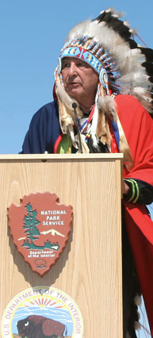
FEDERAL INDIAN LAW:
A Brief Introduction
By Troy A. Eid
Co-Chair, American Indian Law Practice Group
U.S. Attorney for Colorado (2006-09)
Chair, Indian Law & Order Commission (2010-14)
Denver Indian Center
Denver, CO
August 14, 2019

Slide 2

WHAT IS FEDERAL INDIAN LAW?
Legal status of Native nations in the United States as “domestic dependent sovereigns” is unique globally.
Tribal sovereignty imposes limits on federal and state power over tribes and their territories, preserves tribes’ ability to make their own laws and be ruled by them, and recognizes a government-to-government relationship with the United States, subject to the ultimate or “plenary” power of the federal government.

Slide 3
WHAT IS FEDERAL INDIAN LAW?
The term “Federal Indian Law” refers to the thousands of treaties, statutes, executive orders, and court decisions by which the United States defines legal and political status of American Indians and Alaska Native tribes and nations within the federal system, including recognition of tribes’ inherent sovereignty as governments pre-dating the U.S. Constitution.

Slide 4
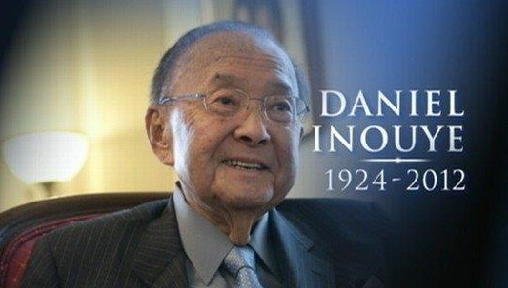
WHAT IS FEDERAL INDIAN LAW?
“This sovereign status of Indian nations is the fundamental premise upon which a course of dealings between the United States and Indian tribal governments ensued and the foundation upon which hundreds of Federal statutes and thousands of Federal court rulings have been based.”

Slide 5
WHAT IS FEDERAL INDIAN LAW?
573 Federally recognized Indian tribes in the United States.
326 of those tribes have permanent homelands in federal trust status (“reservations”) totaling 60 million acres.
Alaska Natives hold an additional 45 million acres pursuant to the Alaska Native Claims Settlement Act and the Alaska Native Allotment Act.
American Indians and Alaska Natives were 1.7 percent of the total U.S. population in the 2010 census.

Slide 6
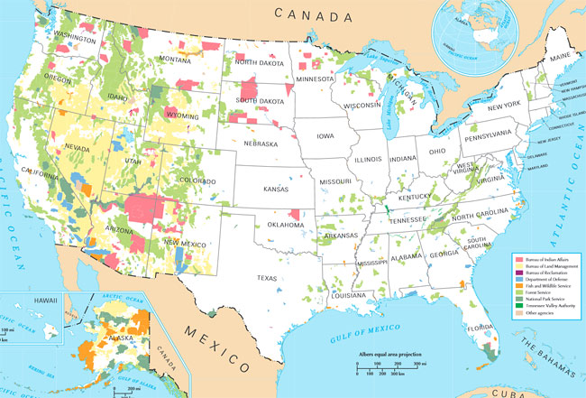

Slide 7
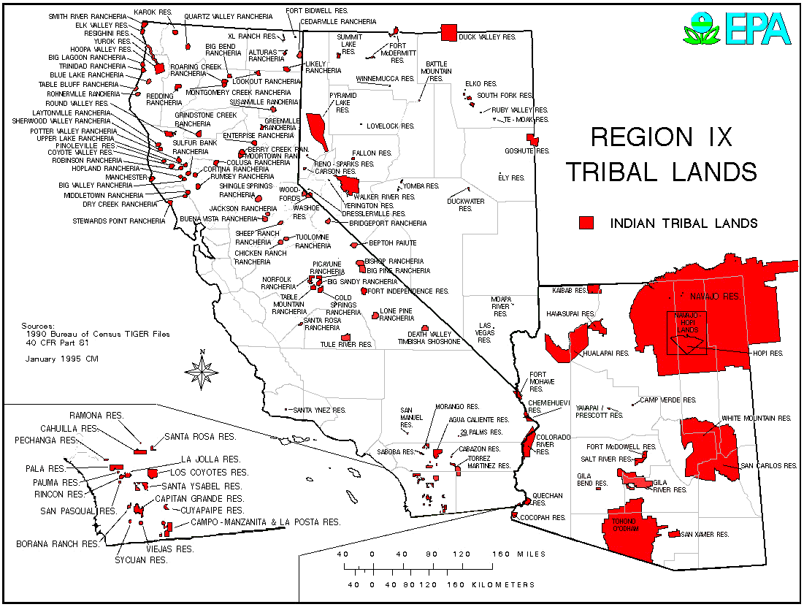

Slide 8
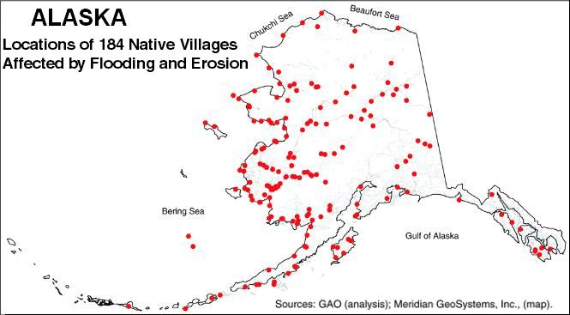

Slide 9
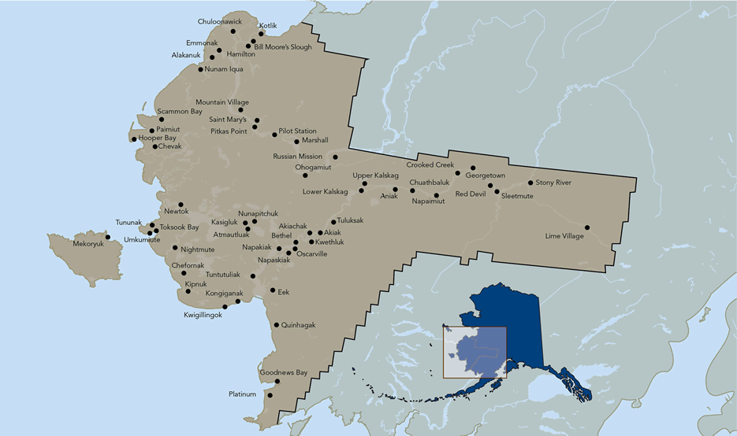

Slide 10
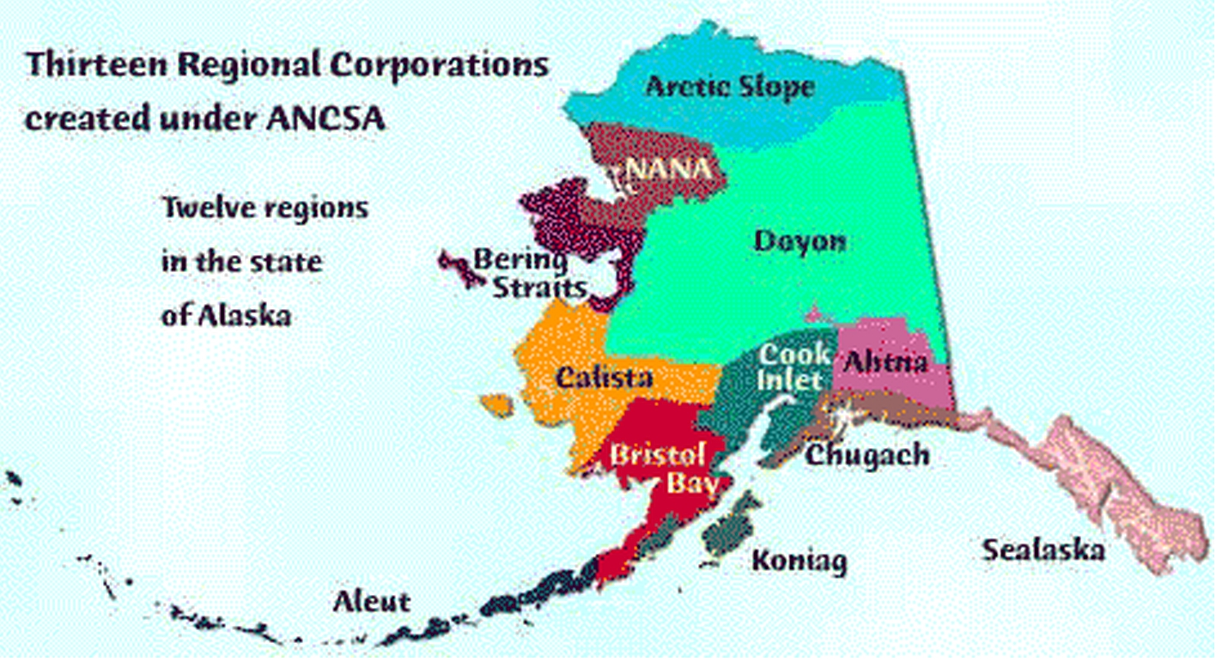

Slide 11
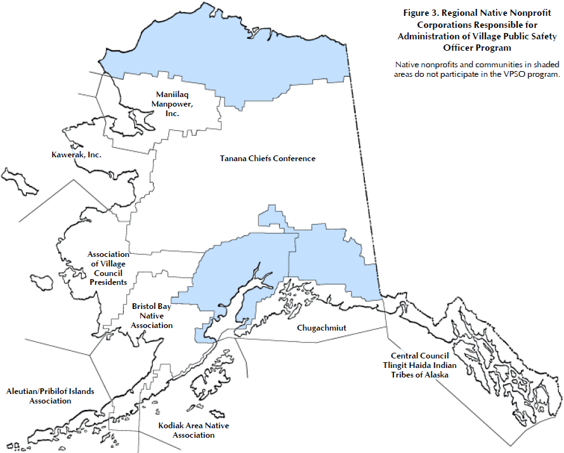

Slide 12
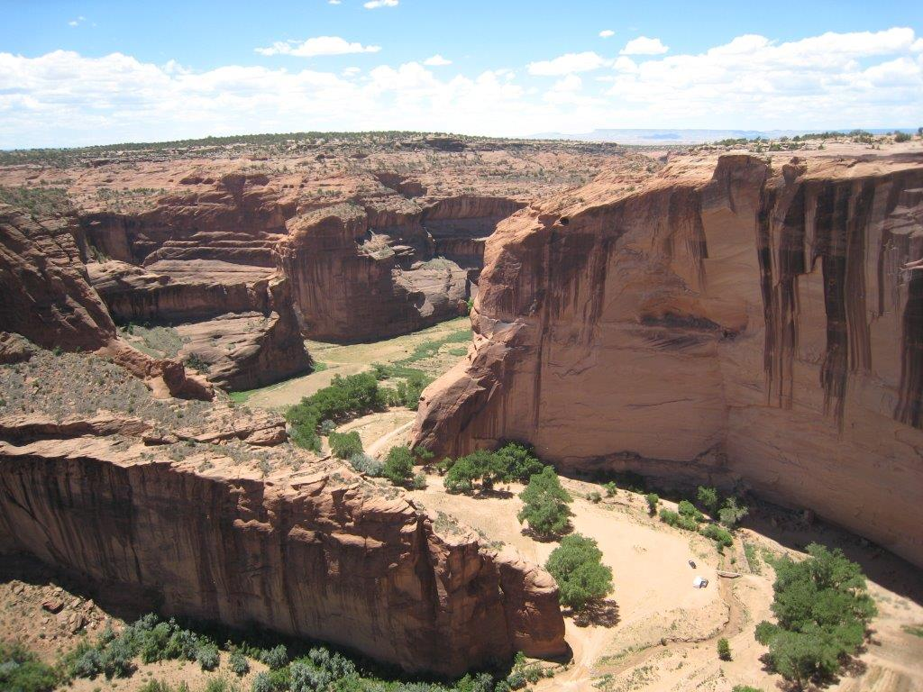
THE WEALTH OF TRIBAL NATIONS
573 Tribes control 56 million acres in continental U.S. plus another 44 million in Alaska.
Indian gaming = $27.4 billion in 2011.

Slide 13
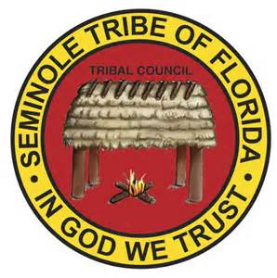
THE WEALTH OF TRIBAL NATIONS
Seminole Tribe of Florida
Bought Hard Rock Café International in ’07 for $965
million, now includes 177 major
properties in 58 countries.
Tribe employs 20,000+ people directly, plus 15,000+ through Hard Rock licensees.
Tribe has roughly 3,800 members.

Slide 14

THE WEALTH OF TRIBAL NATIONS
Ho-Chunk Nation
(Wisconsin)
7,000 enrolled members.
Six casinos net $200 million annually.
Nation makes annual per-capita payments plus one-time payouts of up to $200,000 when 18-year-old members graduate from high school.

Slide 15

THE WEALTH OF TRIBAL NATIONS
Southern Ute Indian Tribe
(Colorado)
1,400 Tribal members.
AAA bond rating with enterprises valued at $4 billion or more.
SUIT Growth Fund has diversified into real estate, including acute-care hospital.

Slide 16

Mercy Regional Medical Center
(Durango, CO)

Slide 17
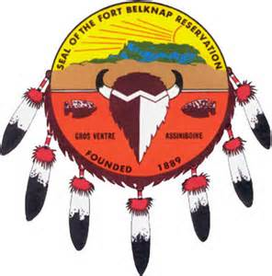
THE WEALTH OF TRIBAL NATIONS
Fort Belknap Indian Community
(Montana)
7,000 Tribal members, 73% unemployment.
Twenty percent (20%) of Tribes’ annual revenues come from on-line consumer lending and financial services.

Slide 18
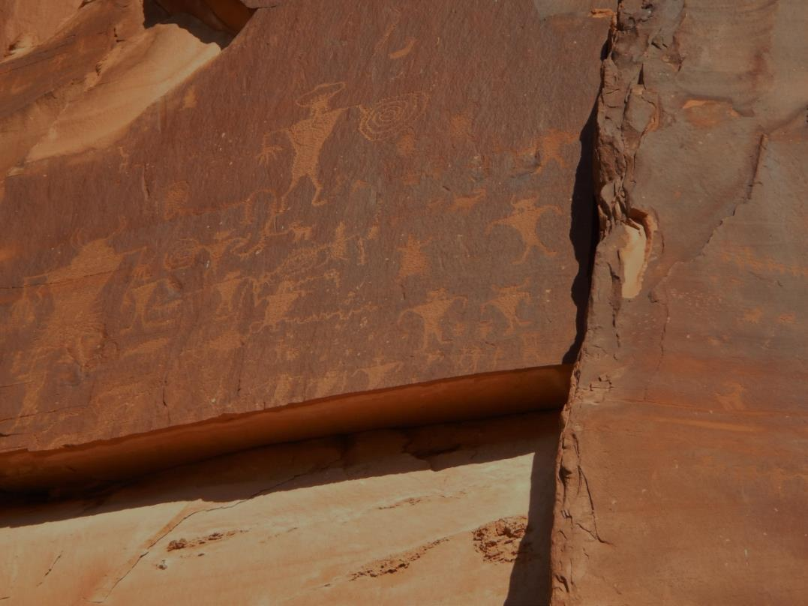
FEDERAL INDIAN LAW 101
US Constitution recognizes three sovereigns – federal, state and tribal.
Tribes’ rights to self-government and land predate the Constitution.

Slide 19
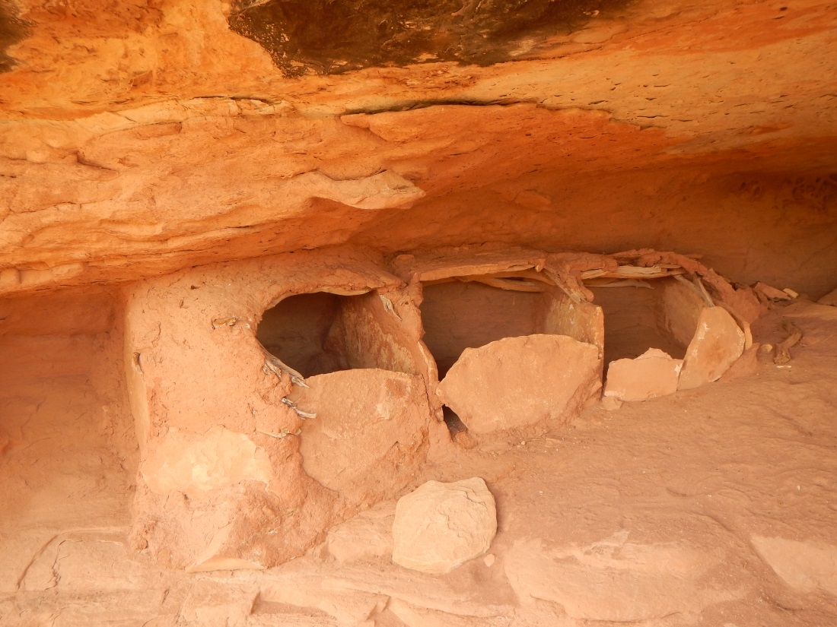
FEDERAL INDIAN LAW 101
Those rights are inherent and continue unless divested by Congress.
State laws do not apply to tribes unless Congressionally authorized.

Slide 20
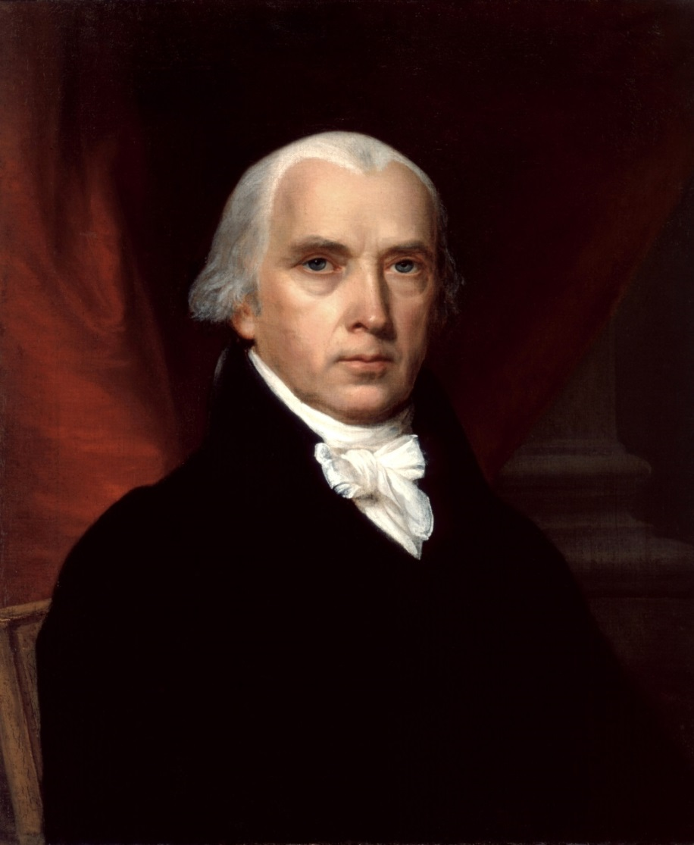
FEDERAL INDIAN LAW 101
Unlike the Articles of Confederation, the Constitution subordinated states’ control over tribal governments.

Slide 21
THE FEDERAL TRUST RESPONSIBILITY
Indian tribes are political and legal entities to which the federal government owes a trust responsibility as a direct result of tribes’ land cessions.
Executive Branch officials are bound “by every moral and equitable consideration to discharge the trust with good faith and fairness.” Seminole Nation v. U.S. (1942).

Slide 22
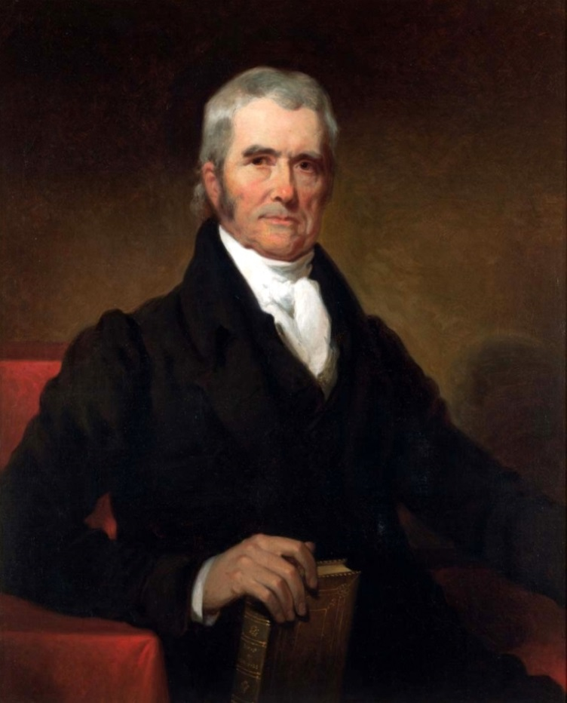
FEDERAL – TRIBAL RELATIONS
“The relation [is] that of a nation claiming and receiving the protection of one more powerful: not that of individuals abandoning their national character, and submitting as subjects to a master.”
Chief Justice John Marshall,
Worcester v. Georgia (1832)

Slide 23
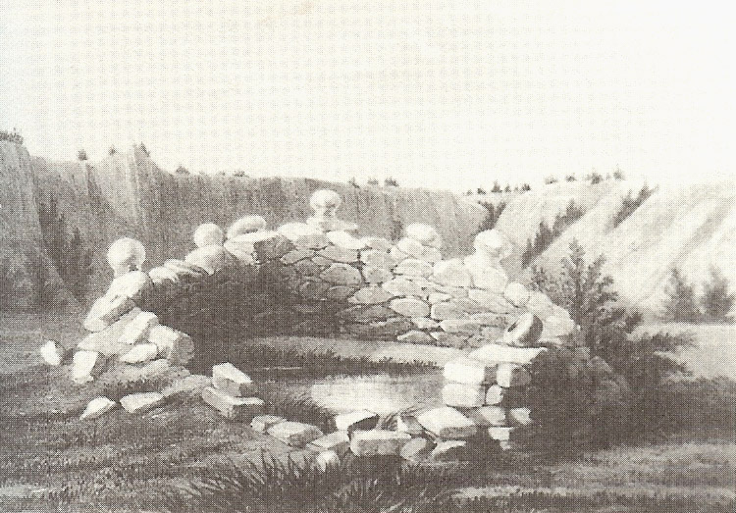
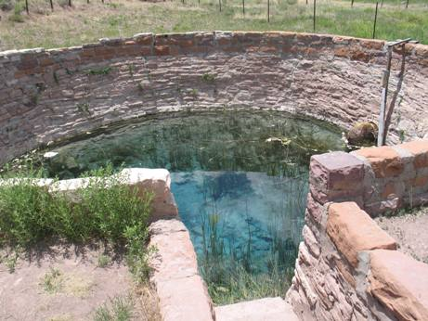
THREE PILLARS OF FEDERAL JURISDICTION
Indian Tribes are Sovereign:
Tribes are domestic dependent sovereigns– independent entities with inherent powers of self-government, but subject to the ultimate authority of the federal government.

Slide 24
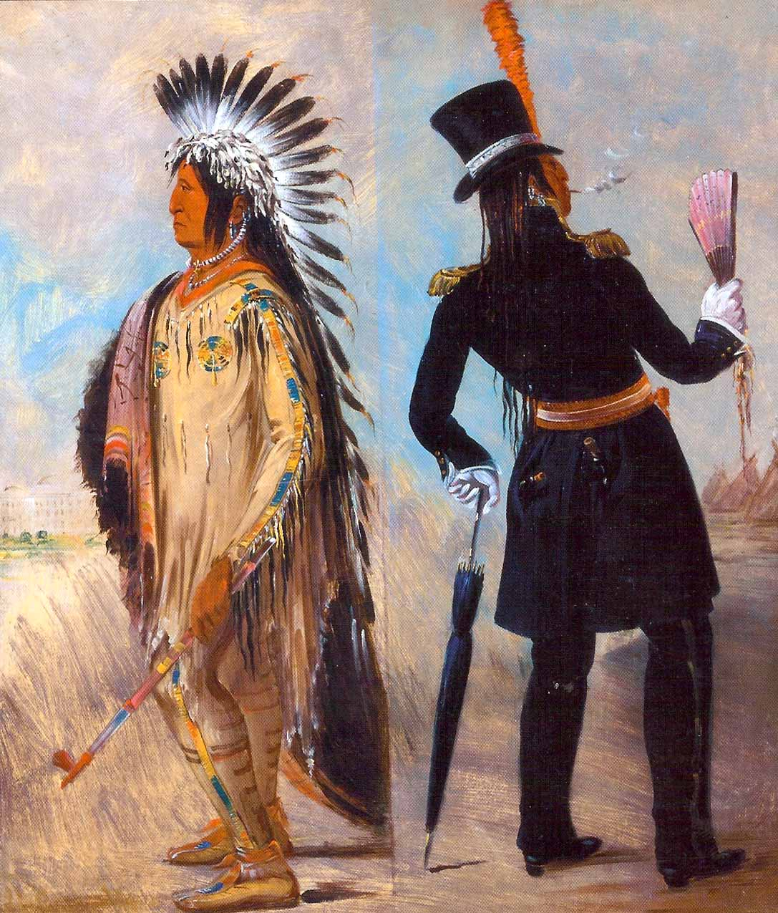
THREE PILLARS OF FEDERAL JURISDICTION
Cherokee Nation v. Georgia (1831) (“Tribes) are in a state of pupilage; their relation to the United States resembles that of a ward to his guardian”).

Slide 25
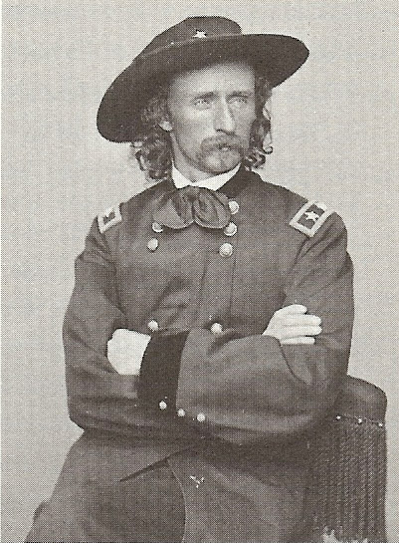
THREE PILLARS OF FEDERAL JURISDICTION
Congress has Plenary Power Over Tribes:
Congress’ power over tribes is plenary – absolute. Santa Clara Pueblo v. Martinez (1978).

Slide 26
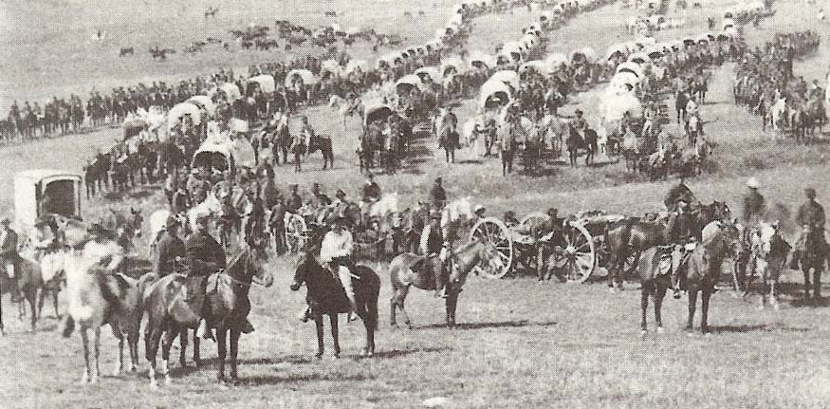
THREE PILLARS OF FEDERAL JURISDICTION
Congress can unilaterally break treaties with tribes and recognize or terminate entire Tribal governments.

Slide 27
THREE PILLARS OF FEDERAL JURISDICTION
Lone Wolf v. Hitchcock (1903) (“Plenary authority over the tribal relations of the Indians has been exercised by Congress from the beginning, and the power has always been deemed a political one, not subject to be controlled by the judicial department of the government”).

Slide 28
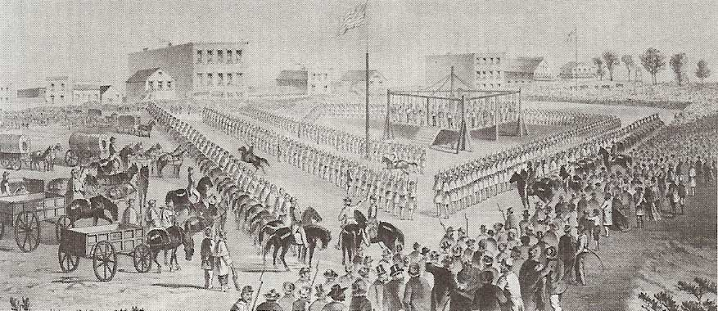
THREE PILLARS OF FEDERAL JURISDICTION
The Major Crimes Act, 18 USC § 1153, is an example of federal intrusion on the traditional power of tribes to even punish their own members for crime, upheld in U.S. v. Kagama (1886).

Slide 29
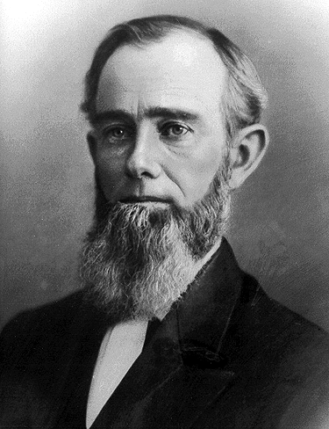
THREE PILLARS OF FEDERAL JURISDICTION
Since the Judiciary Act of 1789, United States Attorneys have been chiefly responsible for enforcing federal criminal law in Indian Country and now act like local District Attorneys.
Samuel E. Brown,
U.S. Attorney-Territory of Colorado (1862-65)

Slide 30
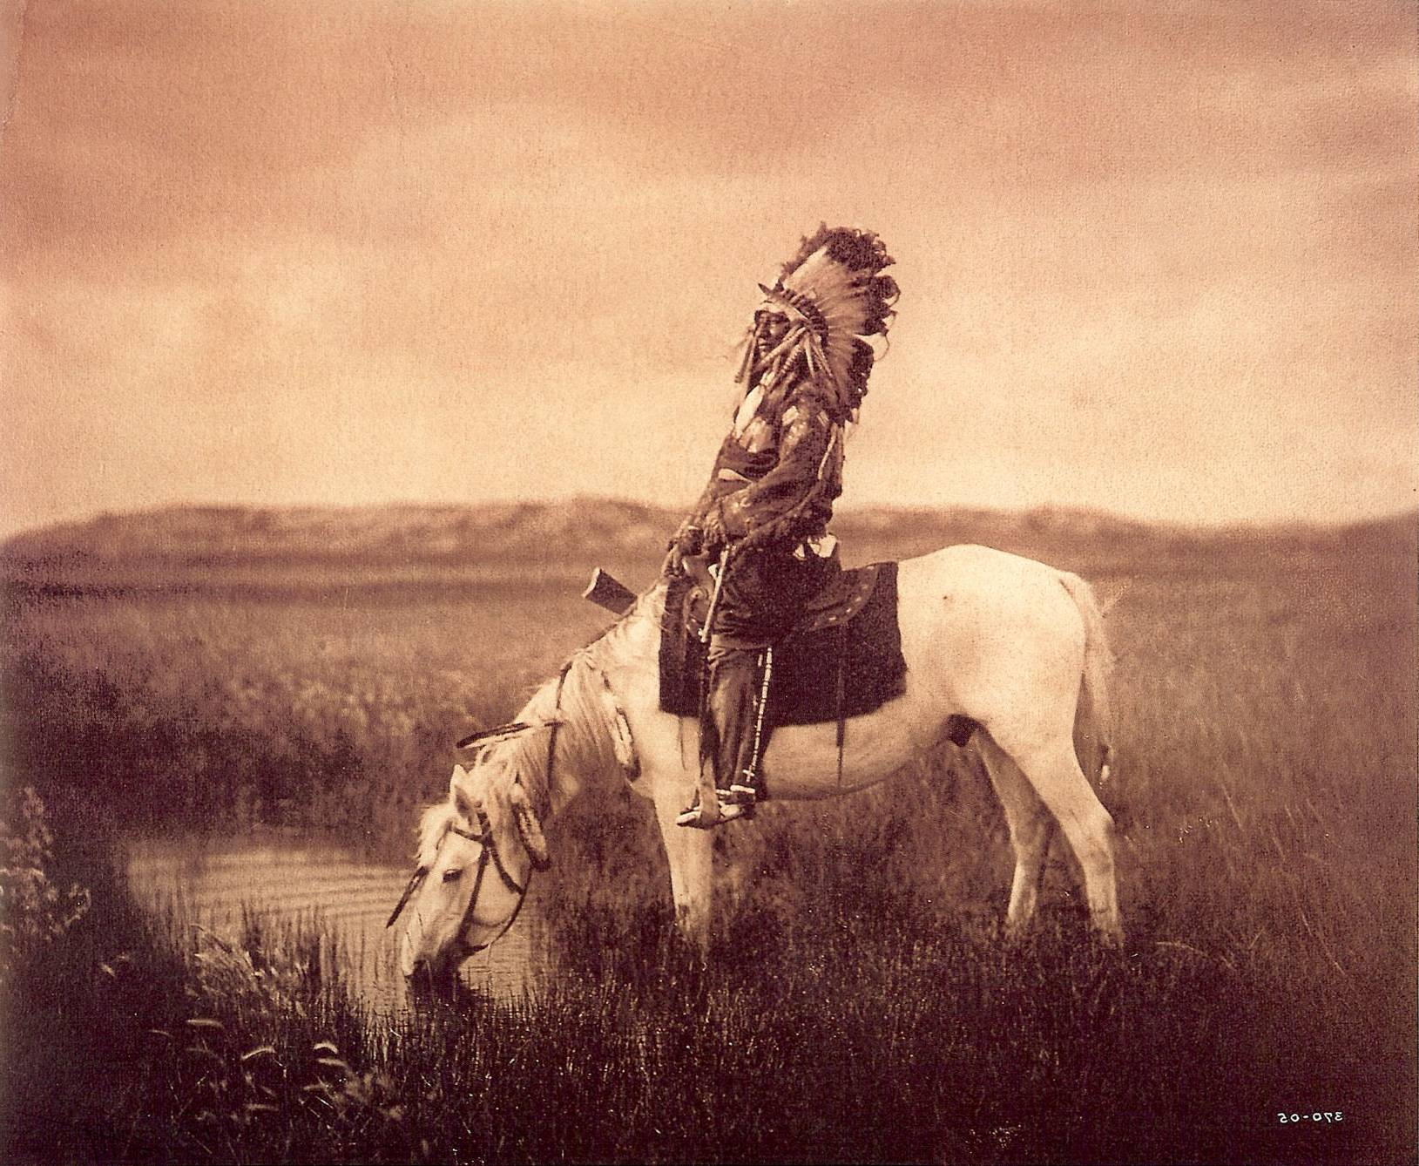
THREE PILLARS OF FEDERAL JURISDICTION
Plenary power means that Congress defines who is an Indian, which tribes are recognized or cease to exist, and what is “Indian Country.”

Slide 31
THREE PILLARS OF FEDERAL JURISDICTION
States generally lack power over Tribes:
The power to regulate tribes is wholly federal; state governments are excluded unless Congress delegates power to them. Worcester v. Georgia (1832) (state law has “no force” in the Cherokee Nation).

Slide 32
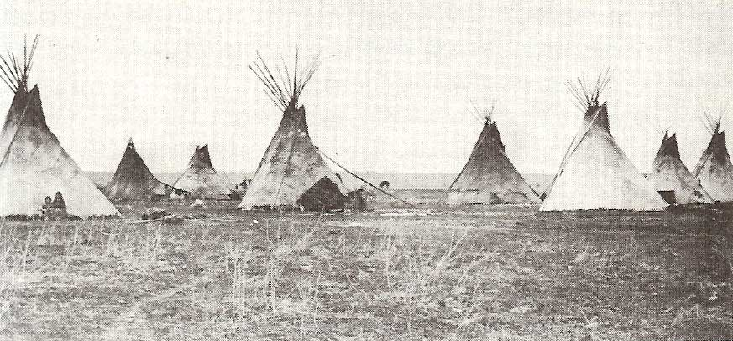
THREE PILLARS OF FEDERAL JURISDICTION
The British Crown tried to stand between Indians and the Colonists, and later the federal government was to stand between tribes and the settlers who formed territorial and later state governments.

Slide 33
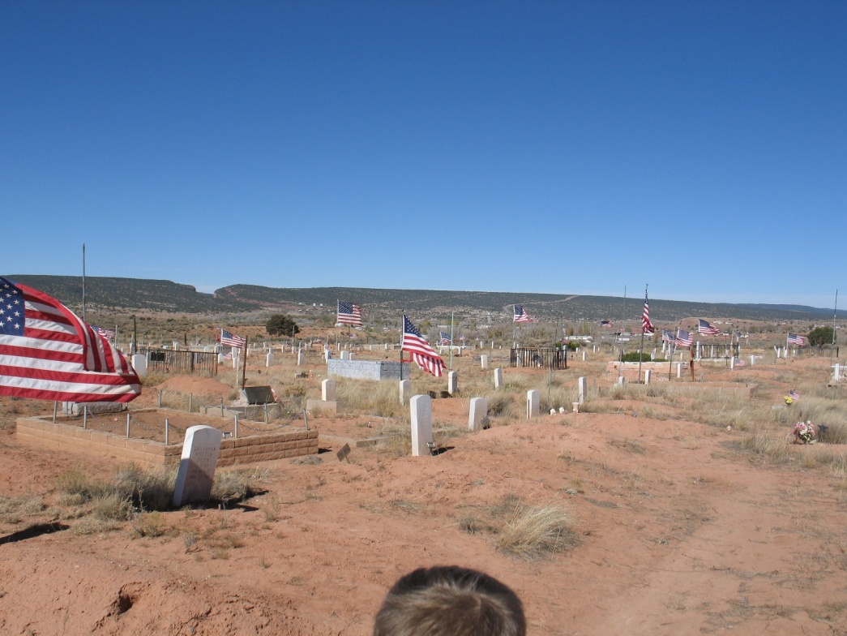
THREE PILLARS OF FEDERAL JURISDICTION
In some states, Indians were forbidden to vote in state elections until after World War II even though they were U.S. citizens.

Slide 34
Fundamental Powers of Tribes include ~
Power to establish a form of government.
Because tribes are not limited by the U.S. Constitution, they are not subject to the Establishment of Religion Clause, Separation of Powers principles, etc.
Authority to define membership (citizenship).
“Police power” to legislate and enforce civil and criminal laws analogous to state government (except Oliphant).
Ability to banish/exclude persons from tribal lands.
Authority to charter business organizations.
Sovereign immunity.

Slide 35
Tribal Sovereign Immunity
Tribal Sovereign Immunity
Sovereign immunity bars any lawsuit, other than claims brought by the United States, absent an express and unequivocal waiver by the Tribe itself or by Congress.
Bars suits by States and individuals against Tribes for any type of activity, whether commercial or governmental.
Applies within or outside Indian country.

Slide 36

DOING BUSINESS WITH TRIBES
For on-Reservation projects, key issues that non-Indian investors and business partners need to understand include:
  Tribal Employment and Labor Laws
  Tribal Regulatory Enforcement
  Investment/Asset Protection
  Dispute Resolution
  Taxation

Slide 37
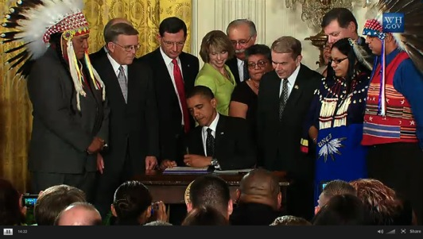
TRIBAL SOVEREIGNTY & EMPLOYMENT
Tribes’ authority to regulate labor and employment within Indian country is an inherent power except when divested by Congress.
Tribes retain the “power to make their own substantive law in internal matters, and to enforce that law in their own forums.”
Santa Clara Pueblo v. Martinez, 436 U.S. 49, 55-56 (1978)

Slide 38
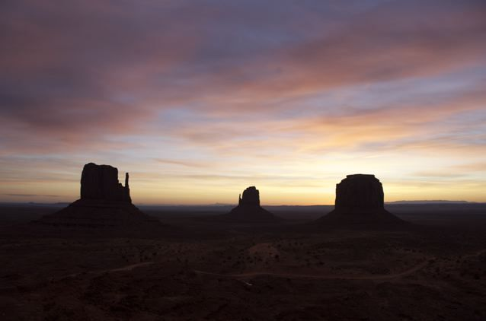
TRIBAL SOVEREIGNTY & EMPLOYMENT
Indian nations also have the “power to raise revenues to pay for the costs of government,” and “to exclude non-Indians from Indian lands,” which “necessarily includes the lesser power to place conditions on entry, on continued presence, or on reservation conduct.”
Merrion v. Jicarilla Apache Tribe, 455 U.S. 130, 144 (1982)

Slide 39
Because of the federal trust responsibility, Indians’ status is political, not an ethnic or racial classification.
“As long as the special treatment can be tied rationally to the fulfillment of Congress’ unique obligations toward the Indian, such legislative judgment will not be disturbed.”
                Morton v. Mancari (1974)

Slide 40
CONTRACTING 101
What are the Tribe’s permitting and business licensing requirements for non-Indian businesses?
What role does the Tribe have in environmental, workplace safety and employment/labor issues, compliance and enforcement?
How is administrative review and regulatory practice addressed through the Tribe’s laws and institutions?

Slide 41
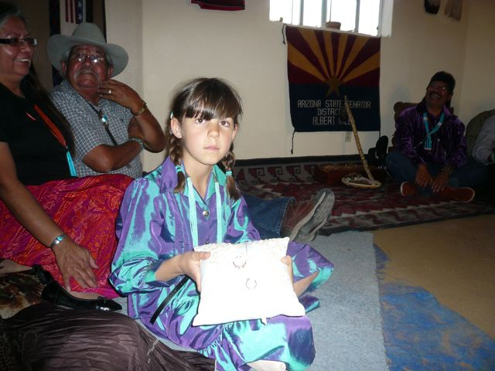
CONTRACTING 101
What role do internal human resource systems, grievance procedures and other processes play when Tribal employees are involved in joint ventures?
How does the Tribe protect its employee’s civil rights?

Slide 42
IF THE TRIBE IS A BUSINESS PARTNER, HOW CAN A NON-INDIAN PROTECT ITS INVESTMENT?
What are the remedies in the event of a contract default?
May a security interest be obtained in Tribal assets? If so, how is that interest perfected?
Are creative options available, such as set-off provisions, revenue obligations, asset-backed obligations, encumbrance of lease-hold interests, damages accounts?
Does the Tribe have a Uniform Commercial Code?
Does the Tribe have an eminent domain ordinance?

Slide 43
HOW WILL DISPUTES BE RESOLVED?
Take the time to understand the Tribal court system and appellate process.
Does the contract require exhaustion of Tribal court remedies?
Analyze applicable Tribal law, including role of traditional law.
Who is authorized to sign for and otherwise bind the Tribe or Tribal enterprise?
Has Tribal sovereign immunity been properly waived?
Does the forum election clause enable enforceable remedies?

Slide 44
  LAWYERS’ DUTIES TO LEARN FEDERAL INDIAN LAW
Rule 1.1 – Duty of Competence.
Preamble to the Model Rules of Professional Conduct – “A lawyer, as a member of the legal profession, is a representative of clients, an officer of the legal system, and a public citizen having special responsibility for the quality of justice.”

Slide 45
CASE STUDY: OCCUPATIONAL SAFETY AND HEALTH ACT
Donovan v. Navajo Forest Product Industries, 692, F.2d 709 (10th Cir. 1982):
Treaty of 1868 between the United States and the Navajo Tribe of Indians prevents OSHA from enforcing federal Occupational Safety and Health Act of 1970 on Navajo trust land.

Slide 46


Slide 47
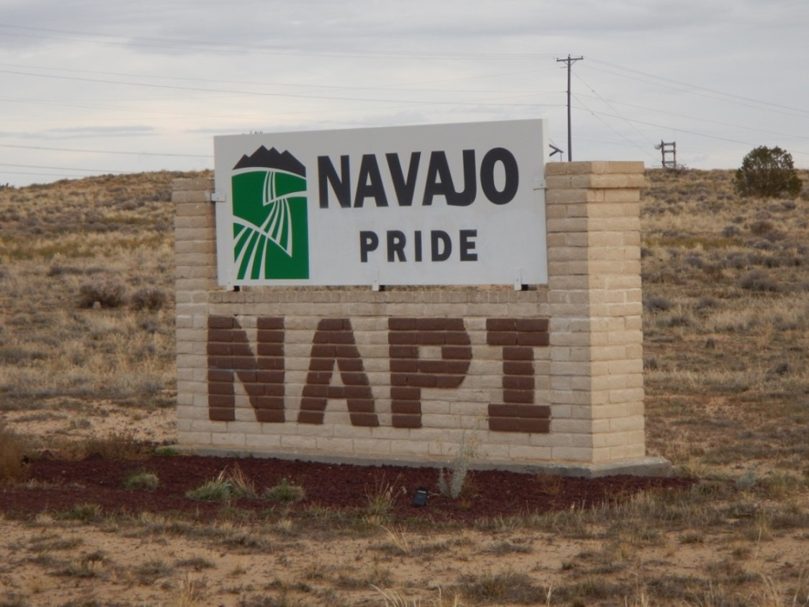
As recently as November 2013, Donovan was recognized by the Solicitor of the U.S. Department of Labor in deferring to the Navajo Nation Occupational Health and Safety Administration’s exclusive authority to regulate workplace safety in the Navajo Eastern Agency.

Slide 48
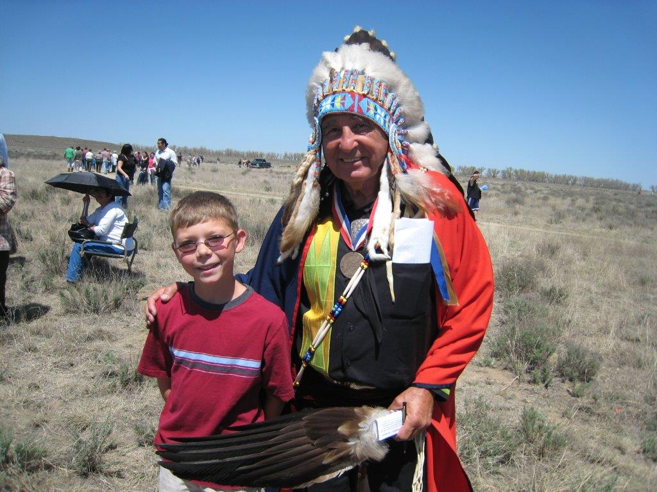
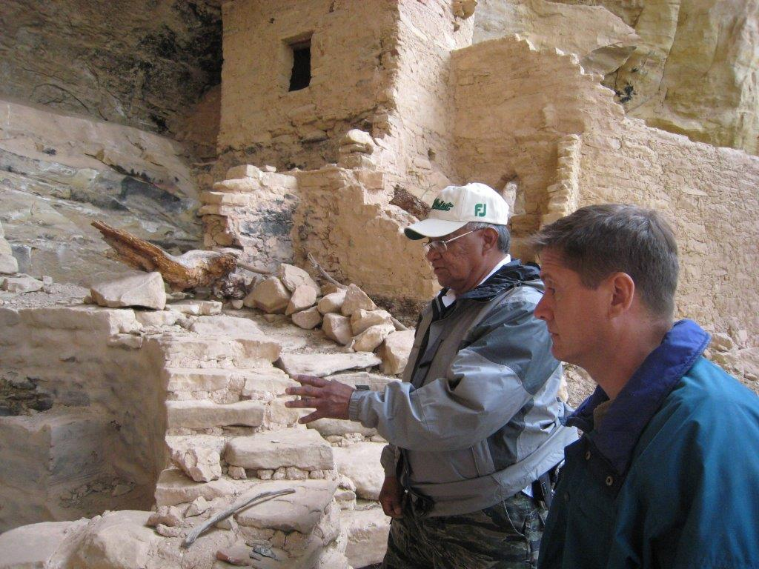
  ETHICS AND CORPORATE RESPONSIBILITY
At least 100 American Indian Tribes have written ethics codes.
Non-Indian companies, and their lawyers, should raise the bar to promote greater corporate responsibility.

Slide 49
  TRIBAL ETHICS REGULATION 101
Avoidance, disclosure of conflicts of interest.
Gift restrictions.
Tribal campaign contributions.
Confidentiality/non-disclosure of business and private information.
“Revolving-door” limits on post-Tribal employment.

Slide 50
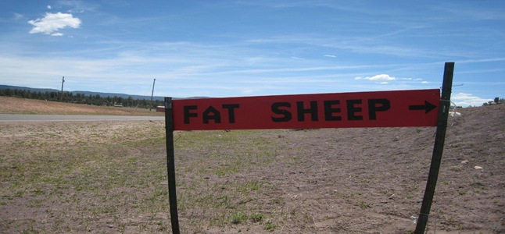
  TRIBES’ EXPECTATIONS OF NON-INDIAN SUPPORT FOR TRIBAL CAPACITY-BUILDING
Some other Tribal Codes expressly encourage officials to seek and accept third-party funds for travel, meals, etc.
Tribes sometimes seek to have non-Indians pay Tribes’ legal fees and other project impacts.

Slide 51
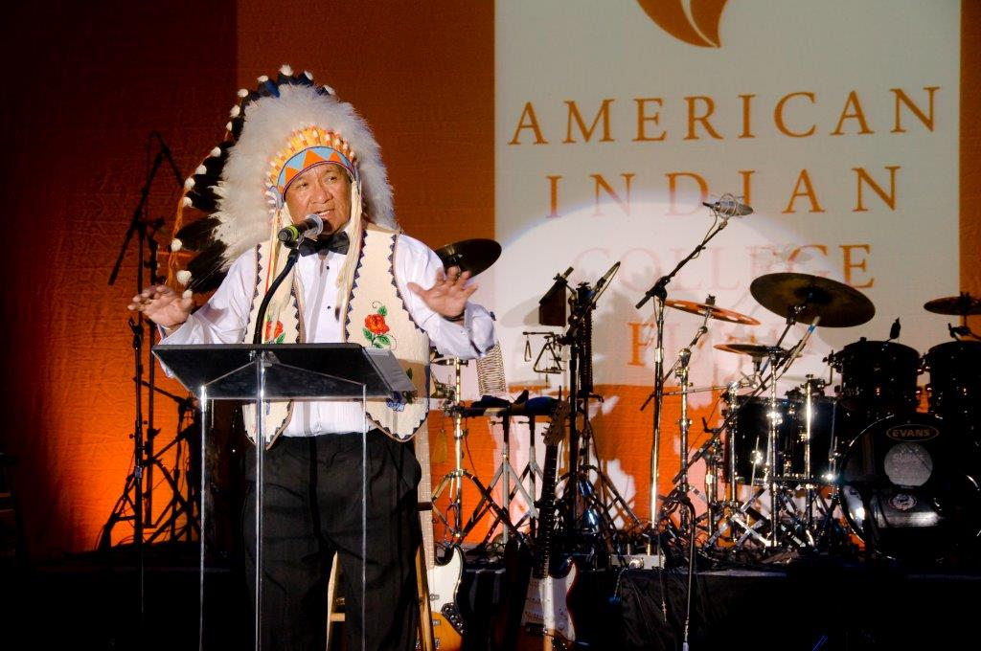
  CORPORATE RESPONSIBILITY TOWARD TRIBES, TRIBAL ENTERPRISES
Know Tribes’ laws, history, and culture.
Build ethics into contracts, course of dealing.
Approve, monitor gift-giving, and other benefits.

Slide 52
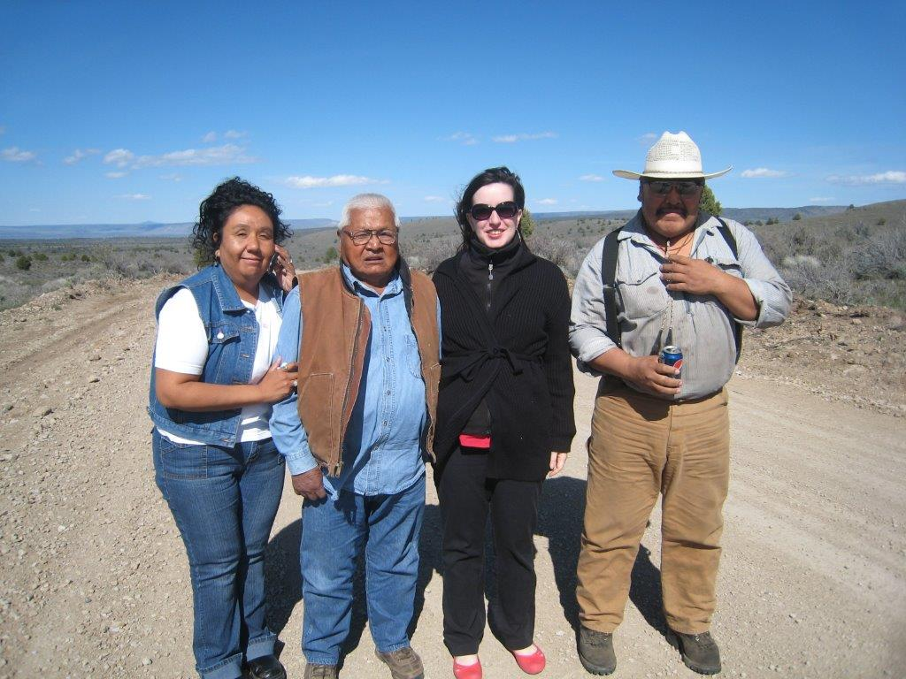
  CORPORATE RESPONSIBILITY TOWARD TRIBES, TRIBAL ENTERPRISES
Don’t get involved in Tribal campaigns.
Target charitable-giving.
Work together to structure tribes’ business operations to encourage accountability and buffer from politics.

Slide 53
  RESPECTING ETHICAL BASELINES
“Like the miner’s canary, the Indian marks the shifts from fresh air to poison gas in our political atmosphere; and our treatment of Indians, even more than our treatment of other minorities, reflects the rise and fall in our democratic faith.”
– Felix Cohen
“The Erosion of Indian Rights”, Yale Law Journal (1953)

Slide 54
FOR MORE INFORMATION:
Troy A. Eid
Greenberg Traurig LLP
eidt@gtlaw.com
www.gtlaw.com

